Slide 1
Query Suggestion by Constructing Term-Transition Graphs
Date: 2012/9/13
Source: Yang Song , Dengyong Zhou , Li-wei Heal(WSDM’12)
Advisor: Jia-ling, Koh
Speaker: Jiun Jia, Chiou

Slide 2
Outline
Introduction
User preference from log
Query suggestion
Topic-based Pagerank model (topic level)
Learning to Rank model (term-level)
Experiment
Conclusion

Slide 3
Introduction
It’s difficult for search engines to fully understand user’s search intent in many scenarios.
Query suggestion techniques aim at recommending a list of relevant queries to user’s input.
User query reformulation activities
Adding terms after the query
Deleting terms within the query
Modifying terms to new terms
Search engine logs
1) stanford university location
2) stanford university address
3) stanford university map → stanford university location

Slide 4
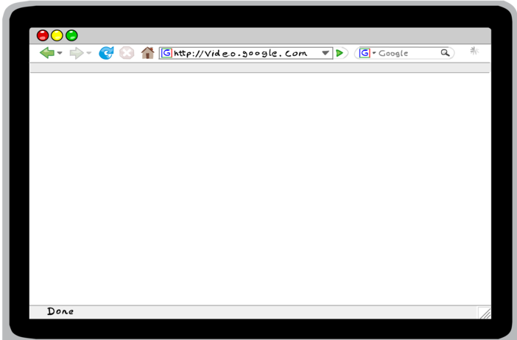
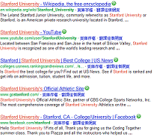
Introduction
four user activities in a session:
{q1, URL1, q2, URL2}
q1
URL1
stanford university
reformulate
q2
stanford university location
satisfy
URL2

Slide 5
Introduction
How to extract high quality user clicks in the user session and use the clicks properly?
it is critical to accurately infer user intent by examining the entire
user search session.
Given a specific query, which query suggestion method should be used?
Can query reduction method be applied to short queries?
Is query expansion always better than query reformulation?

Slide 6
Step 3
Step 2
find user preferences
within each topic
and choose the best
suggestion method
according to the
models.
Step 1
Construct a term transition graph model from the data.
Node:
term in the query
Edge:
a preference
Derive high quality
user clicks by
extracting specific
user activity patterns
which conveys implicit
user preferences.
Ex : tuple {q1, q2, url}

Slide 7
Outline
Introduction
User preference from log
Query suggestion
Topic-based Pagerank model (topic level)
Learning to Rank model (term-level)
Experiment
Conclusion

Slide 8
User preference from log
A typical log entry:
User identification number
organize based on sessions
URL that the user visited
Timestamp of the visit
Contain : a series of URL visits from a particular user, ordered by the timestamp.
Total dwell time on that URL
Statistics: (focus on mining user preference in this paper)
users only modify one of the terms in the queries: ≥76%
users are much more likely to revise the last term in the query : ≥80%
Notes:
PS: If the user becomes inactive for more than 30 minutes, that session ends.

Slide 9
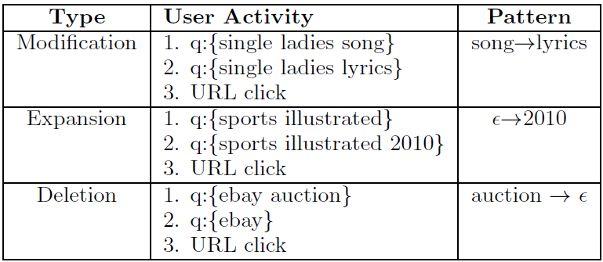
User preference from log
3-month Toolbar logs between May 2010 and August 2010. In total, over 4 million user refinement activities were discovered in the log.
A total of 350,000 pairs of refinements were found.
Three cases of user query refinements

Slide 10
Outline
Introduction
User preference from log
Query suggestion
Topic-based Pagerank model
Learning to Rank model (term-level)
Experiment
Conclusion

Slide 11
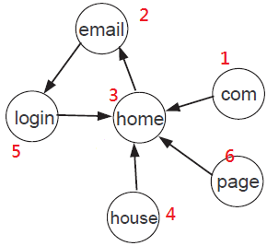
Topic-based Pagerank model
M matrix:
1 2 3 4 5 6
1
2
3
4
5
6
$\left[\begin{matrix}0 & 0 & 0 & 0 & 0 & 0 \\ 0 & 0 & 1/2 & 0 & 1/2 & 0 \\ 1/1 & 0 & 0 & 1/1 & 1/2 & 1/1 \\ 0 & 0 & 1/2 & 0 & 0 & 0 \\ 0 & 1/1 & 0 & 0 & 0 & 0 \\ 0 & 0 & 0 & 0 & 0 & 0\end{matrix}\right]$
Rank^{(t)} matrix:
term transition graph
$\left[\begin{matrix}1/6 \\ 1/6 \\ 1/6 \\ 1/6 \\ 1/6 \\ 1/6\end{matrix} \right]$
Mij = 1/N(j) if there is a transition from node j to node i, with N(j) being the total number of outlinks of node j.
Initial rank value
Notes:
§1: the more inlinks a webpage has, the higher its authority score is.

Slide 12
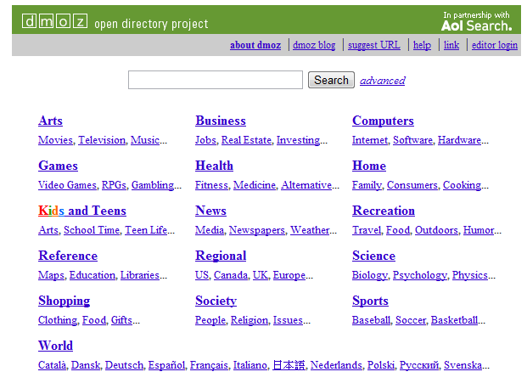
Arts
Business
Computers | Com , Email , Home, House , Login , Page
Games
Health
Home
Kids and teens
News
Recreation
Reference
Regional
Science
Shopping
Society
Sports
World
P_{computers,com}=1/6
p_{computers,email}=1/6
p_{computers,home}= 1/6
$\left[\begin{matrix}0.166 \\ 0.166 \\ 0.166 \\ 0.166 \\ 0.166 \\ 0.166\end{matrix} \right]$
p matrix:
p_{computer,house}= 1/6
p_{computers,login}= 1/6
p_{computers,page}= 1/6

Slide 13
Arts
Business
Computers | Com , Email , Home, House , Login , Page
Games
Health
Home
Kids and teens
News
Recreation
Reference | Com , Email , Login , Page
Regional
Science
Shopping
Society
Sports
World
P_{reference,com}=1/4
$\left[\begin{matrix}0.25 \\ 0.25 \\ 0 \\ 0 \\ 0.25 \\ 0.25\end{matrix} \right]$
p_{reference,email}=1/4
p matrix:
p_{reference,home}= 0
p_{reference,house}= 0
p_{reference,login}= 1/4
p_{reference,page}= 1/4

Slide 14
α:0.5
$\left[\begin{matrix}0 & 0 & 0 & 0 & 0 & 0 \\ 0 & 0 & 1/2 & 0 & 1/2 & 0 \\ 1/1 & 0 & 0 & 1/1 & 1/2 & 1/1 \\ 0 & 0 & 1/2 & 0 & 0 & 0 \\ 0 & 1/1 & 0 & 0 & 0 & 0 \\ 0 & 0 & 0 & 0 & 0 & 0\end{matrix}\right]$ X
$\left[\begin{matrix}1/6 \\ 1/6 \\ 1/6 \\ 1/6 \\ 1/6 \\ 1/6\end{matrix} \right]$
$\left[\begin{matrix}1/6 \\ 1/6 \\ 1/6 \\ 1/6 \\ 1/6 \\ 1/6\end{matrix} \right]$
(1-0.5)x
+0.5 x
Rank^{(t)}
$\left[\begin{matrix}0 \\ 0.083 \\ 0.292 \\ 0.042 \\ 0.083 \\ 0\end{matrix} \right]+$
$\left[\begin{matrix}0.083 \\ 0.083 \\ 0.083 \\ 0.083 \\ 0.083 \\ 0.083\end{matrix} \right]=$
$\left[\begin{matrix}0.083 \\ 0.167 \\ 0.375 \\ 0.125 \\ 0.167 \\ 0.083\end{matrix} \right]$
com
email
home
house
login
page
$\left[\begin{matrix}0.083 \\ 0.219 \\ 0.271 \\ 0.177 \\ 0.167 \\ 0.083\end{matrix} \right]$
Rank^{(t+1)}
Rank^{(t+2)}

Slide 15
Query Suggestion
Query Term refinement probability:ggestion
Given a query qi with m terms {w_{i1}, ..., w_{ij} , ..., w_{im}}
w_{iJ} :map
w’_{iJ} :location
T₁ :Regional
T₂ :Art
T₃ :Computers
….
….
T₁₆ :
Stanford university map
Stanford university location
Query (q)
New Query (q’)
P(w_{iJ} → w’_{iJ} |T₁ )=0.3[Pagerank value] P(T₁ | q’)= 6/10
Only consider the top-10 URLs returned by a search engine into ODP categories
P(w_{iJ} → w’_{iJ} |T₂ )=0.5[Pagerank value] P(T₂ | q’)= 4/10
P(w_{iJ} → w’_{iJ} |q’)=0.3*0.6+0.5*0.4 =0.38
Notes:
P(w_{iJ} → w’_{iJ} |T₁ ) :其方式由前方所述的pagerank值而來 P(T₁ | q’):代表此新的query再透過搜尋擎回傳的top10 URL有幾筆有列在該topic類別中

Slide 16
Arts
Business
Computers | Com , Email , Home, House , Login , Page
Games
Health
Home
Kids and teens
News
Recreation
Reference | Com , Email , Login , Page
Regional
Science
Shopping
Society
Sports
World
P_{reference,com}= 1
$\left[\begin{matrix} 1 \\ 1 \\ 0 \\ 0 \\ 1 \\ 1 \end{matrix} \right]$
p_{reference,email}= 1
p matrix:
p_{reference,home}= 0
p_{reference,house}= 0
p_{reference,login}= 1
p_{reference,page}= 1

Slide 17
Term frequency
In ODP categories
Term refinement
probability
Query (q)
New Query (q’)
Stanford university map
Stanford university location
P(q’| q)=P(map)*P(map→location|q) =4/16*0.04=0.01
Stanford university address
P(q’| q)=P(map)*P(map→address|q) =4/16*0.02=0.005
Stanford colleage location
Stanford school location
Harvard university location

Slide 18
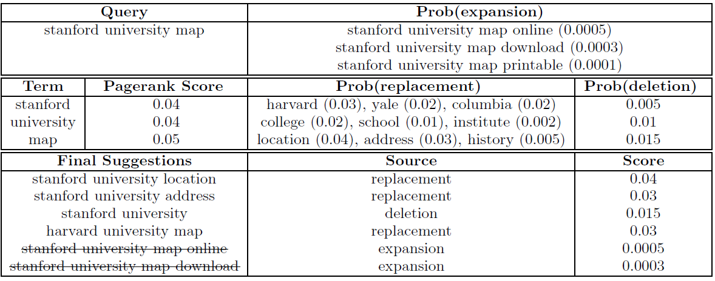
§ : Suggestions from using expansion gets a very low score

Slide 19
Outline
Introduction
User preference from log
Query suggestion
Topic-based Pagerank model(topic level)
Learning to Rank model (term-level)
Experiment
Conclusion

Slide 20
Learning to Rank model
Given a set of queries and labeled relevance score (usually in 5-scale) for each query pair.
learning-to-rank tries to optimize for the ranking loss for all queries in the training set.
Three sets of features:
Query Features | Is the query a Wikipedia title? ∈ {0, 1} Is the query a Wikipedia category? ∈ {0, 1} # of times query contains in Wikipedia title ∈ R # of times query contains in Wikipedia body ∈ R
Term Features | Pagerank score of the term # of inlinks & outlinks entropy of Pagerank score in 16 ODP topics: −∑i P(ti) log P(ti) # of times derived from EMPTY node
Query-Term Features | N-gram conditional probabilities, p(wn|wn−m+1, ..., wn−1) Inverted Query Frequency: logN(ti)/N(ti|qj )
Notes:
Query feature: 8 million Wikipedia articles in English, which contains the Title , Body content and Category information.
The corpus contains 7,181,315 titles and 10,170,187 articles.

Slide 21
Query-Term Features : N-gram conditional probabilities (P(term|N-gram))
Stanford university
map
query
term
P(Stanford university map) = P(Stanford)*P(university|Stanford)*P(map|Stanford university)
= $\frac{4}{5}$*$\frac{3}{4}$*$\frac{2}{3}$ =0.4
N=0 P(Stanford) =$\frac{4}{5}$
N=1 P(university|Stanford)
=$\frac{count(Stanford\&university)}{count(Stanford)}$
=$\frac{3}{4}$ $\frac{\{log2,3,4\}}{\{log1,2,3,4\}}$
User log1
{map,Stanford map,click URL1}
User log2
{Harvard university map,Stanford university map,click URL2}
User log3
{Stanford university map,Harvard university map,click URL3}
User log4
{Stanford university ,Harvard university ,click URL4}
User log5
{university map,Harvard university map,click URL5}
N=2 P(map|Stanford university)
=$\frac{count(\text{Stanford} \text{university} \& map)}{count(\text{Stanford} \text{university})}$ =$\frac{2}{3}$ $\frac{\{log2,3\}}{\{log2,3,4\}}$

Slide 22
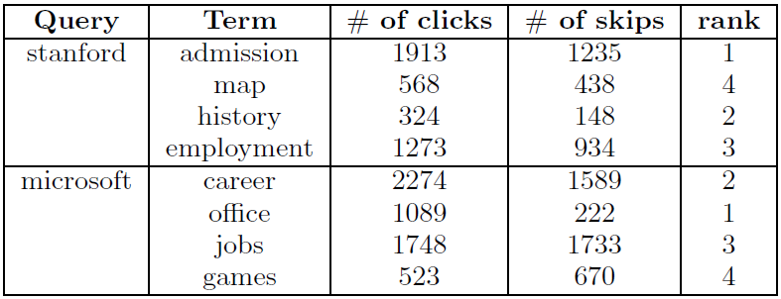
Generate ranking labels for each group of query refinements
Training labels automatically from implicit user feedbacks in the log.
─ Training tuple {q₁, q₂, click_{url}}
─ clicks and skips (α, β)
─ given a refined query q’ for the original query q
probability of click distribution using a function
─ compare two query refinements q₁ and q₂
P(stanford admission > stanford map) = 0.61
P(stanford map > stanford history) = 0.08
Threshold:0.5
Notes:
§1 :The query “stanford admission” is a clear winner over “stanford map”with higher number of clicks and relative less number of skips.
§2 :“stanford map” is ranked lower than “stanford history”. the former query has more clicks but also significantly more skips that the latte

Slide 23
Training data
rank
query1 | term 1 | Feature 1,F2,F3…F30 | 2
 | term 2 | """""""""" | 1
 | term 3 | """"""""""" | 3
query2
query3
.......
Build
model
Test data
query1 | term 1 | Feature 1,F2,F3…F30
 | term 2 | """"""""""
 | term 3 | """""""""""
query2
query3
.......
0.789
0.456
0.123
….
….
….
Predict
Ranking score

Slide 24
Given a new query q that contains k terms: {t₁, ..., t_{k}}
Create a candidate set of queries
Ex: query{t1, t2, t3} q₁ q₂ q₃ q₄
the candidate set contains {t1, t2}, {t1, t3} ,{t2, t3}and {t1, t2, t3}.
Predict Ranking score
{t1, t2} | term 1 | Feature 1,F2,F3…F30 | 0.7694
 | term 2 | """""""""" | 0.3788
 | term 3 | """"""""""" | 0.8037
{t1, t3}
{t2, t3}
{t1, t2, t3}
The highest scored terms are suggested for the query
{t1, t2}+term3 →{t1, t2,term3 }

Slide 25
Outline
Introduction
User preference from log
Query suggestion
Topic-based Pagerank model(topic level)
Learning to Rank model (term-level)
Experiment
Conclusion

Slide 26
Experiment
1) Performance of the two proposed models
2) Calibrate the parameters of methods
user study and ask judgers to evaluate the query suggestion performance of metohds
Metrics:
Normalized discounted cumulative gain (NDCG)
use the top-5 suggested queries for evaluation
Relevance score(rel):
Perfect (5), Excellent (4), Good (3), Fair (2) and Poor(1)
Zero/one-error

Slide 27
Query
Query suggestion
Stanford university
Top i | Query suggestion | rel
1 | Query+Term1 | 5
2 | Query+Term2 | 3
3 | Query+Term3 | 4
4 | Query+Term4 | 3
5 | Query+Term5 | 2
5
4
3
3
2
=$\frac{5}{log2}$+$\frac{3}{log3}$+$\frac{4}{log4}$+$\frac{3}{log5}$+$\frac{2}{log6}$
=10.96
IDCG(q)=$\frac{5}{log2}$+$\frac{4}{log3}$+$\frac{3}{log4}$+$\frac{3}{log5}$+$\frac{2}{log6}$ = 11.09
NDCG(q)=$\frac{10.96}{11.09}$ = 0.988

Slide 28
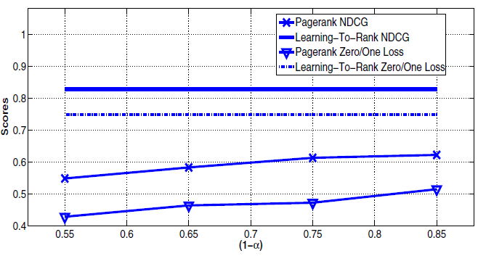
Zero/one-error
Query suggestion( Top 5)
Rank → | 1 | 2 | 3 | 4 | 5
Train | Term1 | Term2 | Term3 | Term4 | Term5
Test | Term1 | Term4 | Term3 | Term5 | Term2
Zero/one-error
=2/5=0.4
Notes:
The two horizontal lines correspond to the learning-to-rank approach which is not affected by α.
It can be noticed that when (1 − α) increases, Pagerank generally performs better and better. The best NDCG score is achieved at 0.85 for Pagerank with the value of 0.61, whereas learning-to-rank achieves 0.82 NDCG — a 25% better performance. Similarly, Pagerank has the best zero/one loss score of 0.52, comparing to 0.75 for learning-to-rank algorithm.

Slide 29
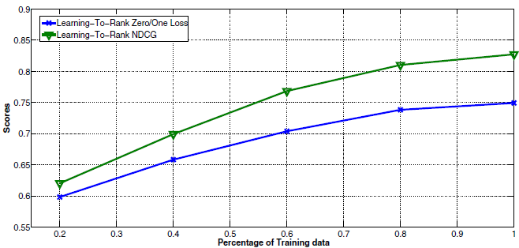

Slide 30
3 different judgers and the majority vote is used as the final label.
Relevant
(2) irrelevant
(3) no opinion (hard to judge)
Rank(N) | Query suggestion | Judger vote | P(N)
1 | q₁ | Rel | 1/1
2 | q₂ | Irrel | 1/2
3 | q₃ | Irrel | 1/3
4 | q₄ | Rel | 2/4
5 | q₅ | Rel | 3/5
1 when query at j is relevant
0 otherwise
AverageP(q_{i}) =$\frac{1+2/4+3/5}{3}$=0.7

Slide 31
Query 1
Query 2
……………………….Query K
Rank(N) | Query suggestion | P(N)
1 | q₁₁ | 1/1
2 | q₁₂ | 1/2
3 | q₁₃ | 1/3
4 | q₁₄ | 2/4
5 | q₁₅ | 3/5
Rank(N) | Query suggestion | P(N)
1 | q₂₁ | 0
2 | q₂₂ | 1/2
3 | q₂₃ | 2/3
4 | q₂₄ | 3/4
5 | q₂₅ | 4/5
rel
Irrel
Irrel
Rel
Irrel
Rel
Rel
Rel
Rel
Rel
If K=2, P@1 =$\frac{1+0}{2}$=0.5 P@5 =$\frac{0.6+0.8}{2}$=0.7
AverageP(q₁) =$\frac{1+2/4+3/5}{3}$=0.7
AverageP(q₂)=0.5
If K=2 , MAP=(0.7+0.5)/2=0.6

Slide 32
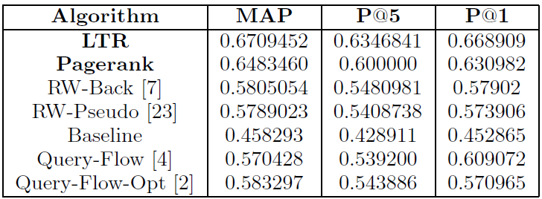
P@5
Short: ≤ 2, medium: [3, 5] and long: ≥ 6
Notes:
baseline model: only takes query frequency into consideration
§ 1-1: LTR improves 2.2% of MAP, 2.4 % P@5 and 3.8% P@1 upon the Pagerank algorithm
§ 2-1: long queries are generally the most difficult to make suggestions.
§ 2-2:While for short and medium queries, the expansion technique indicates better suggestion performance than deletion and modification.

Slide 33
Conclusion
A novel query suggestion framework which extracted user preference data from user sessions in search engine logs.
used the user patterns to build two suggestion models.
- topic-based PageRank model
- Learning to Rank model
User study was conducted where all queries are triple-judged by human judgers. Experimental results indicated significant improvement on two models.
Model only considered changing one term from the queries, how the performance will increase/decrease by leveraging a more sophisticated user preference extraction model which could consider multi-term alteration.

